Slide 1
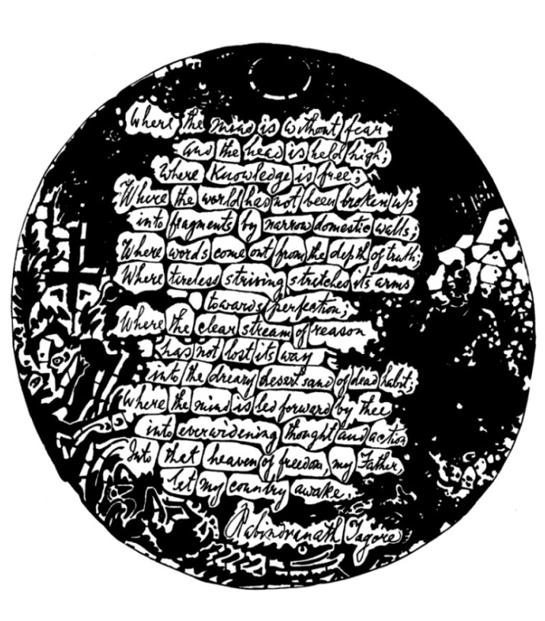
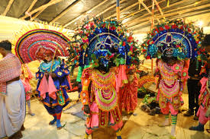
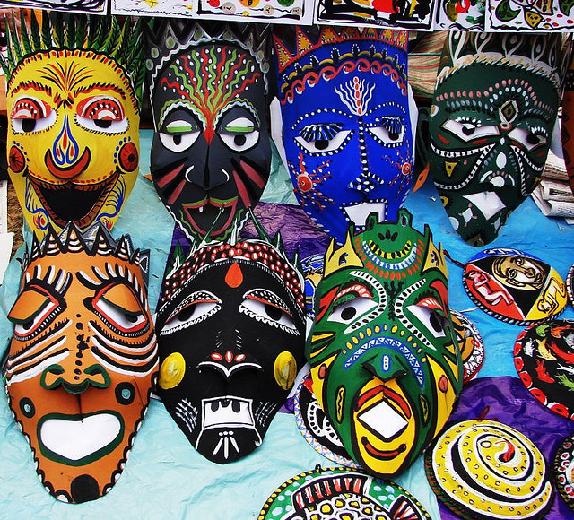
Introduction to Museums: An Overview
Dr. Saswati Pal Choudhuri
Asst. Professor
Tagore Institute of art and Education
Barwan University

Slide 2
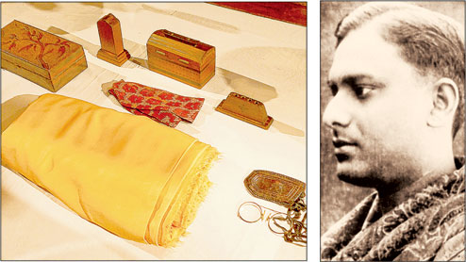
2nd An Appeal from Rathindranath
Visva-bharati News, August, 1946
On the Sacred occasion of the fifth anniversary of the passing away of Rathindranath Tagoire, Founder President of the Visva-Bharati, santiniketan, I appeal once more to his numerous admirers and friends, Who have in their possession some memento of his, either in the form of letters addressed by him to them or any of his manuscripts, or any photograph of special significance, to present these, in a spirit of magnamity, to the Rabindra-Bhavana, Santiniketan. For, in this institution, as is well known, an attempt is being made for the last three years to collect and preserve all such materials as pertains to the poet’s life and works, so that scholars intending to carry on research on any aspect of these, may have an easyaccess to them. If, however, they are not willing to part with them, they would kindly send authentic copies thereof or sendthe originals to be copied out at the Bhavana, and ultimately returned to them. I sincerely hope that they would respond generously to my present appeal.”
Notes:
On the Sacred occasion of the fifth anniversary of the passing away of Rathindranath Tagoire, Founder President of the Visva-Bharati, santiniketan, I appeal once more to his numerous admirers and friends, Who have in their possession some memento of his, either in the form of letters addressed by him to them or any of his manuscripts, or any photograph of special significance, to present these, in a spirit of magnamity, to the Rabindra-Bhavana, Santiniketan. For, in this institution, as is well known, an attempt is being made for the last three years to collect and preserve all such materials as pertains to the poet’s life and works, so that scholars intending to carry on research on any aspect of these, may have an easyaccess to them. If, however, they are not willing to part with them, they would kindly send authentic copies thereof or sendthe originals to be copied out at the Bhavana, and ultimately returned to them. I sincerely hope that they would respond generously to my present appeal.”

Slide 3
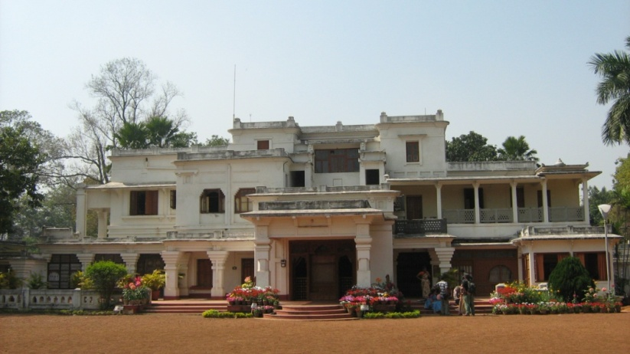
Beginning & History of Development
Established Rabindra-Museum on 1st July 1942
1st meeting (17-08-1942) of Museum Subcommittee and decided main vision was established a Rabindra Research Centre along with Rabindra-Museum .
2nd meeting (13-10-1942) discussed about aim and objective of Rabindra-Museum and emphasis on Rabindra-Charcha.
3rd meeting (November 1942) committee decided to change the name from Rabindra-Museum to Rabindra-Bhavana.
Member of Subcommittee were Rathindranath Tagore, Khitimohan Sen, Nandalal Bose, Suren kar, Anil Kumar Chanda, Krishna Kripalani etc.
Notes:
Begining

Slide 4
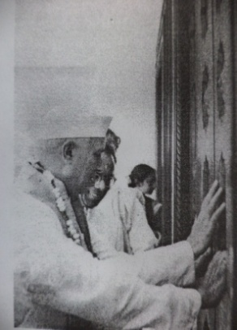
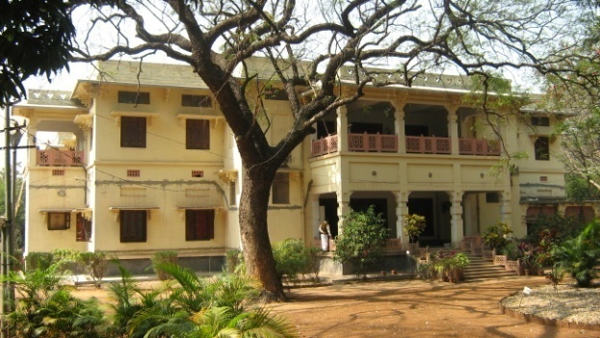
History of Development
7th May 1961 Museum Shifted From Udayana to Vichitra, Innagurated by The then Prime Minister Pandit Jawahar Lal Nehru.
Six separate Department or Section
Museum, Archives, Library, Audio-Visual, Preservation.
2nd May, 1962 According to Karma Samiti Rabindra-Bhavana became a Educational Institution or Bhavana and initiated Professor post for Rabindra-Gabesana.
Special evaliuation team of 3rd Loksava proposed for Development of Rabindra-Bhavana as a Research Centre.
1967 Rabindra-Charcha Prakalpa.
on 1970 according to the will of Partima Devi, Rabindra-Bhavana initiated a fund on the memory of Rathindranath Tagore for develoment and research of Rabindra-Bhavana.
1984 according to new Loksava law of Visva-Bharati , the Director of rabindra-Bhavana will be the Adhyakha , Culture and cultural relation of Visva-Bharati.
Notes:
History of Development

Slide 5
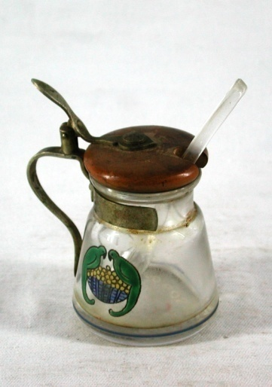
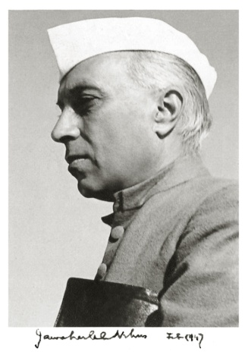
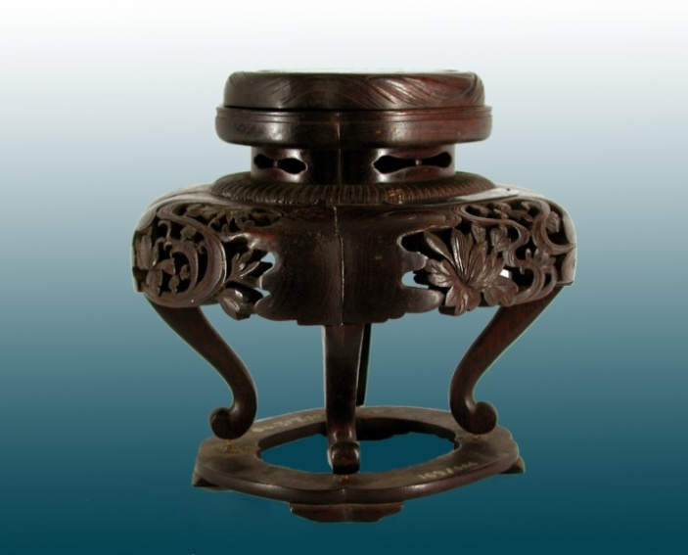
Rabindra-Bhavana
Collections at a glance
Total number 4115
Gold 19
Box, caskets etc 73
Personalia 214
Coin 6
Watches and clocks 8
Medals, degrees 303
Textile 47
Utensils 421
Wood work & leather craft 183
Kutum Katum 36
Sculptures 67
Swords 5
Type writer 2
Musical instruments 7
Tagore paintings 1582
Painting by other artists 703
Miscellaneous 229
Photo-Archives and Audio-Visual Collection
Approximately 15,000 photographs
Approximately 60,000 negatives
Glass negatives
Audio recordings
Video recordings
Autographed photographs

Slide 6
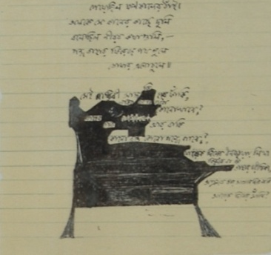
Rabindra Bhavana
Archives
at a Glance
Tagore manuscripts 1026 files
Press proofs 32 files
Correspondence (English) 513 files
Correspondences (Bengali) 960 files
Dwarkanath Tagore papers 8 files
Deendranath Tagore papers 5 files
Tagore family correspondence 30 files
Andrews papers 32 files
Visva-Bharati papers 22 files
Suprakash Ganguli collection 20 files
Mira Devi-Krapalani collection 50
P.C Mahalanobish collection 50
Manuscripts of
Rabindranath Tagore
Mahatma Gandhi
Albert Einstein
Helen Keller
Romain Rolland
Benito Mussolini
W.B. Yeats
Subhas Chandra Bose
Jawaharlal Nehru
Sarvapalli Radhakrisnan
Lord Chelmsford
Chittaranjan Das
Jagadish Chandra Bose
Okakura Kakuzo

Slide 7
Museum Galleries
1.Vichitra !st Floor Gallery
2. Vichitra Ground Floor Galleries
a. Gitanjali Hall
b. Thakur Barir Kalyanira.
c. Bramhavidyalaya to Visva-Bharati
3. Rathindra Museum in Guhaghar.
4. Pratimadevi Museum in Chitra-Bhanu.
5. Devendra Kakkha in Santiniketan Griha.
6. Dwijenra Kakkha in Santiniketan Griha.
7. Period room in Udayana Griha, Konaraka Griha, Shyamali
Griha, Udichi Griha etc.

Slide 8
Intangible Heritage
Education System
Study with in nature
Oral Tradition
Baul Song and Other traditional folk songs
Performing Arts
Dance, Drama, Programmes and festivals etc.

Slide 9
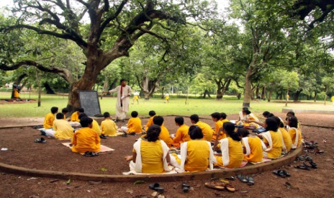
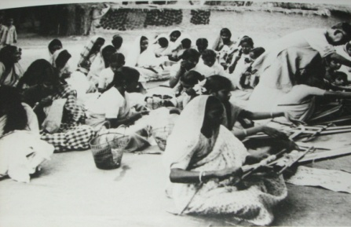

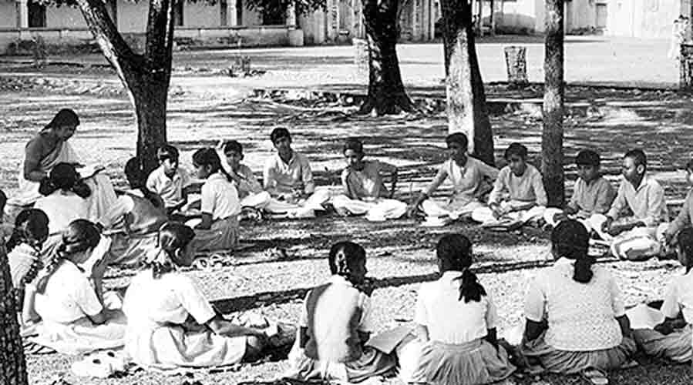
Educational System introduced by Tagore in Visva-Bharati
Vinaya-Bhavana
Teaching Education
Palli Charcha
Rural Development Education
Sangeet-Bhavana
Performing Art Education
Kala-Bhavana
Creative Art Education
Siksha-Bhavana
Science Education
Vidya-Bhavana
Arts Education
Uttar Siksha Sadana
Intermediate Education
Patha-Bhavana & Siksha Satra
Children
Education with in Nature up to Matriculation
Palli Siksha Bhavana
Occupa tion Oriented Education

Slide 10
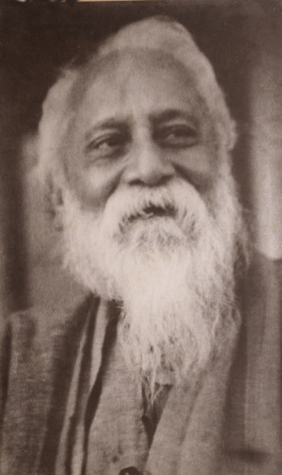
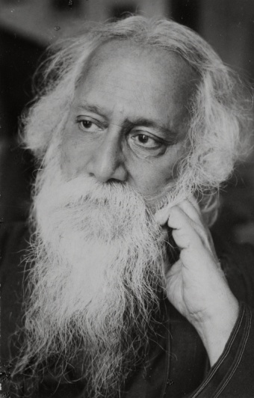
Different Cultural Programmers and Festivals of Santiniketan
Maharshi Smaran (20 January)
Maghotsava (25January)
Sriniketan Utsava (6, 7 & 8 February)
Vasanta Panchami (On the day of Sree Panchami)
Vasanta Utsava (Holi Festival)
Varsha Sesh (Bengali year ending festival)
Nava Varsha Anusthan (Bengali new year festival)
Janmotsava (25, Baishakha, Poet’s birthday)
Vriksha Ropana (22, Shravana, death anniversary of Tagore)
Halakarshna (23 Shravana)
Rabindra Saptaha (8-14 August week long discussion on Tagore)
Varsamongal (16 August)
Sharadotsava (15 day-Drama Festival)
Ananda Bazar (Handicrafts fair by School Students)
Nandan Mela (1, 2 December)
Pous Utsava (23 December – 25 December)
Khristotsava (25 December)
Gandhi Punyaha (10 March)
With those Tangible and Itangible heritage the Santiniketan became “……….. a place where the world makes its home in a single nest.”

Slide 11
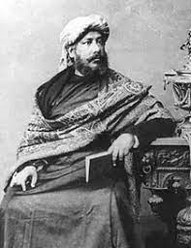
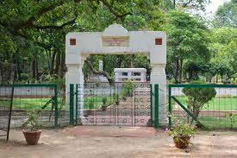
Maharshi Smaran
(20 January)
Maharshi Devendranath Tagore
Chhatim Tala

Slide 12
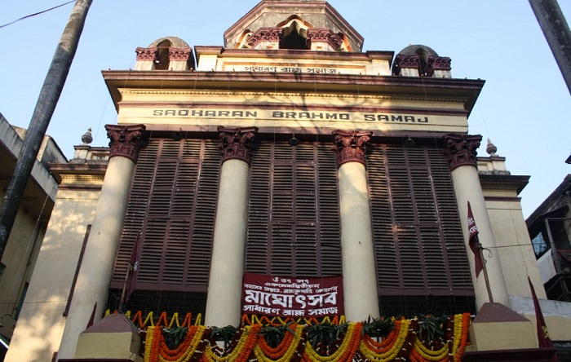
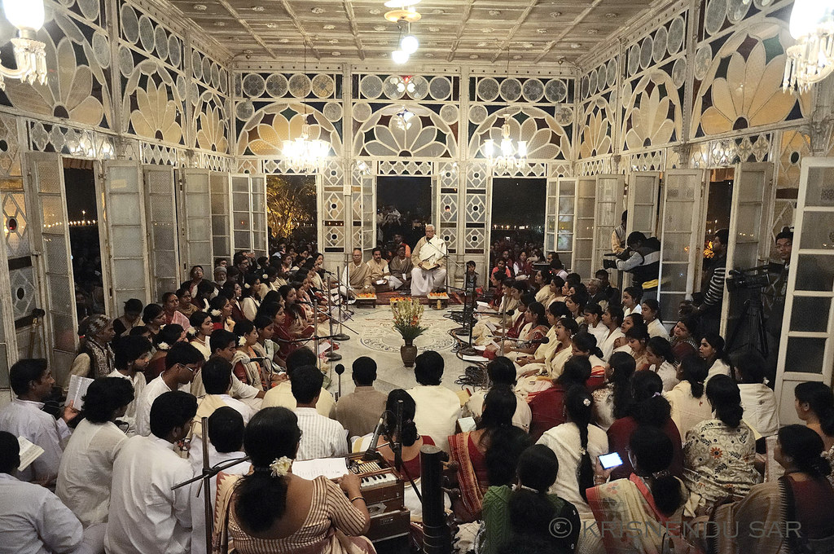
Maghotsava (25January)

Slide 13
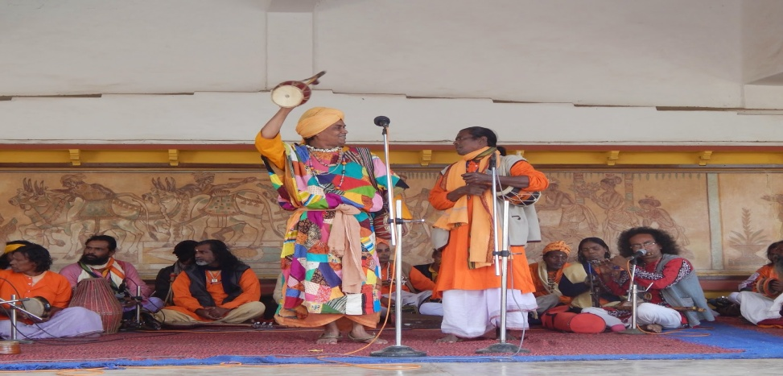
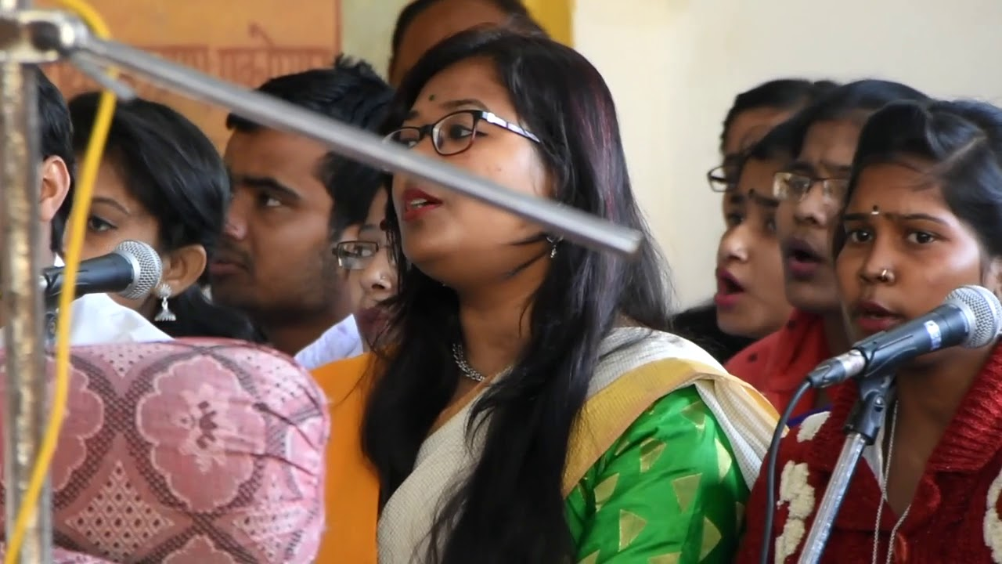
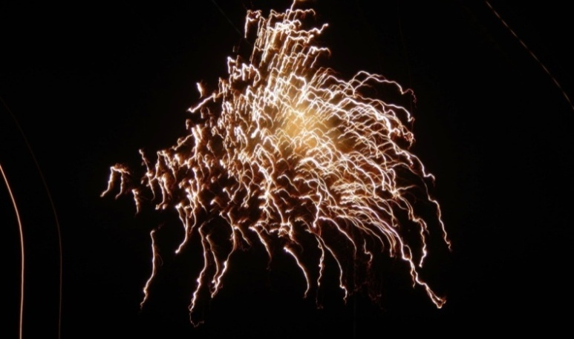
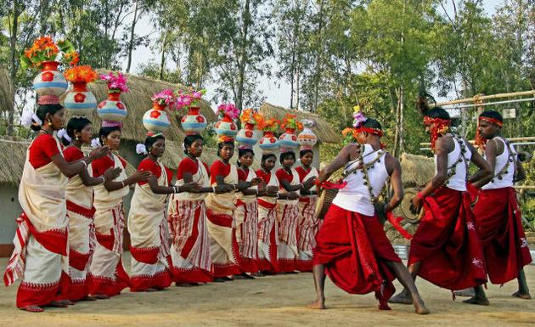
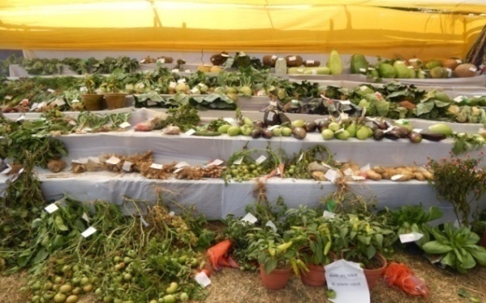
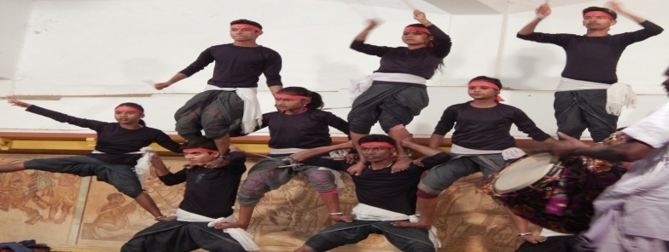
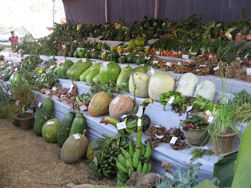
Sriniketan Utsava (6, 7 & 8 February)
Stage programmes
Fire play
Adibashi Nritya
Raibeshe Nritya
Crops Exhibition

Slide 14
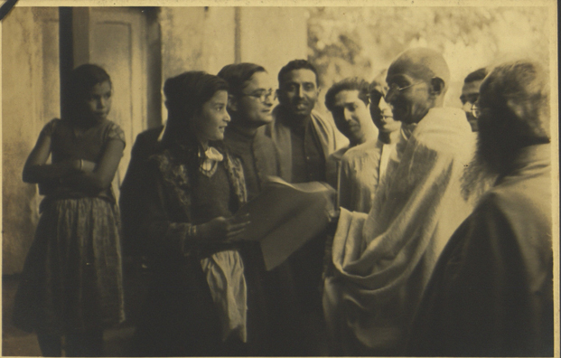
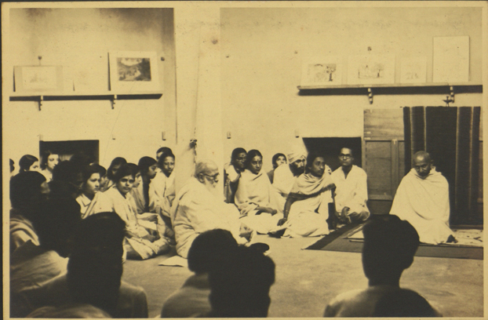
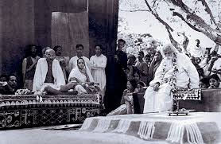
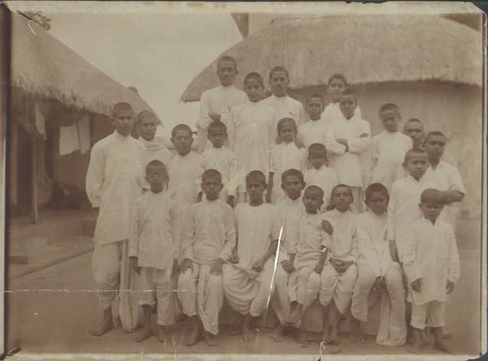
Mahatma and phoenix School Student separately at Santiniketan
Notes:
Gandhiji and Finix School Student seperately at Santiniketan

Slide 15
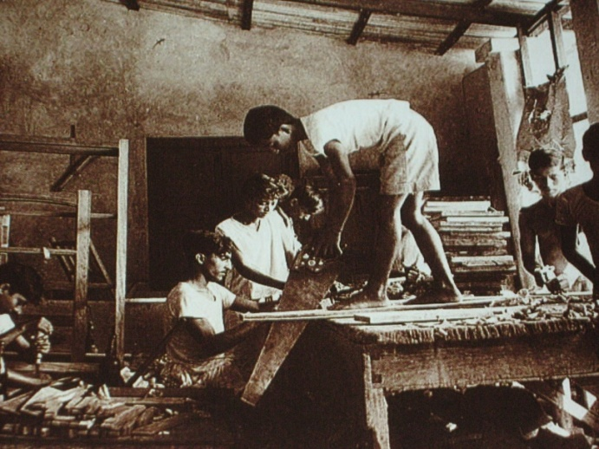
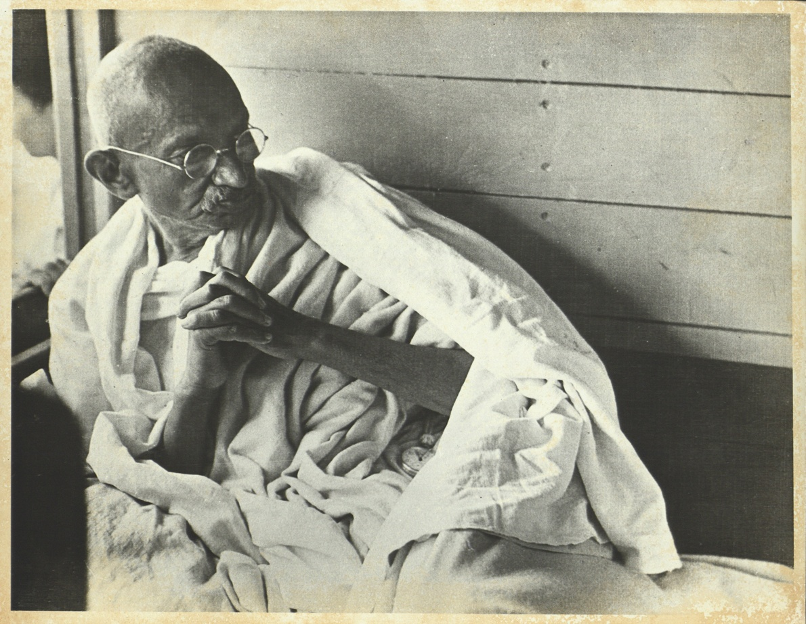
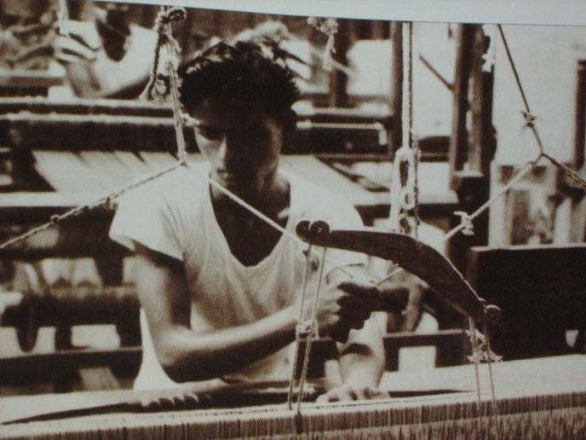
Gandhi Punyaha (10 March)
Ghandhi Punnaha on 10 March till now we follow on the memory of Ghandhiji

Slide 16
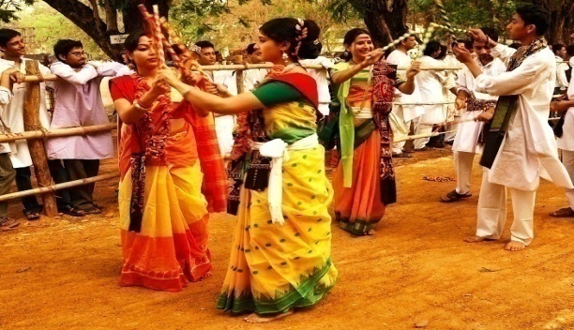
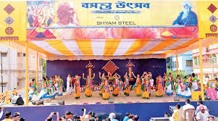
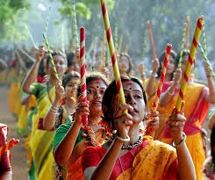
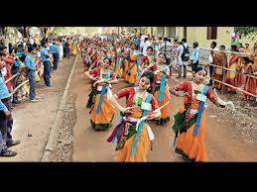
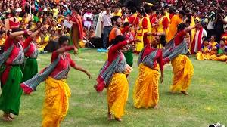
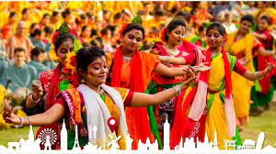
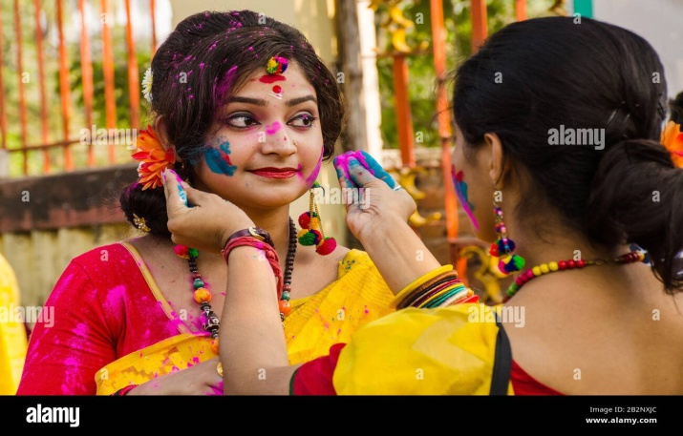
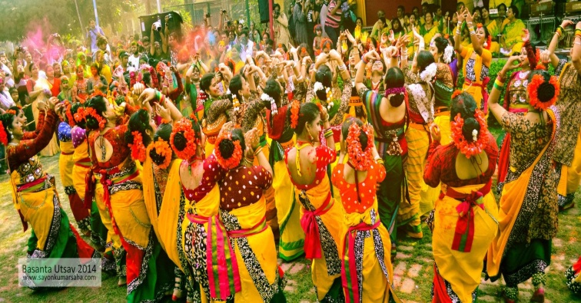
Vasanta Utsava
Colour Festival

Slide 17

Vasanta Utsava (Holi Festival)

Slide 18
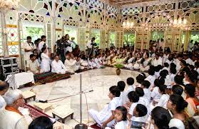
Nava Varsha Anusthan (Bengali new year festival)
Varsha Sesh (Bengali year ending festival)

Slide 19
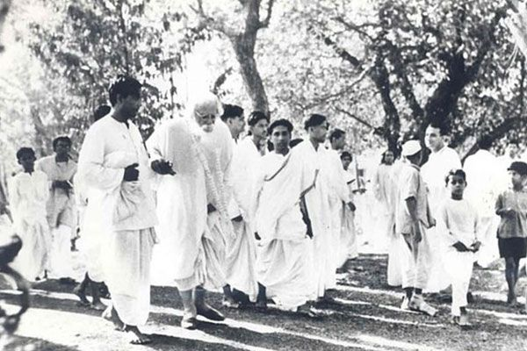
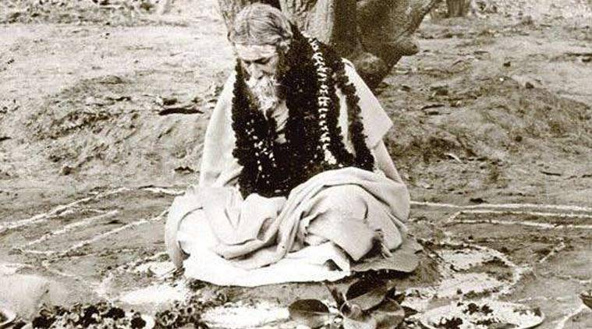
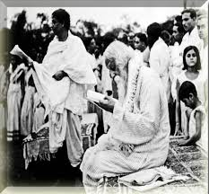
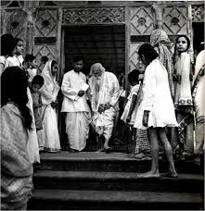
Janmotsava (25, Baishakha, Poet’s birthday)

Slide 20
Boitalik

Slide 21
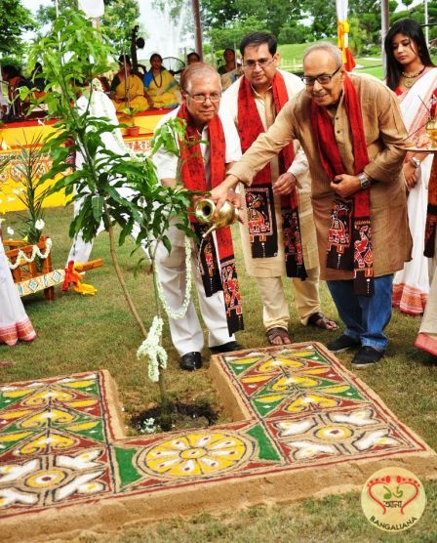
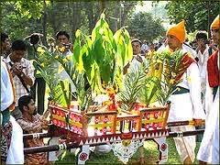
Vriksha Ropana
(22, Shravana, death anniversary of Tagore)

Slide 22
Brikharopona anusthan at Visva-Bharati, Santiniketan

Slide 23
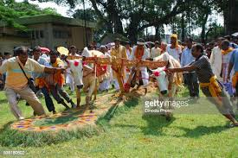
Halakarshna (23 Shravana)

Slide 24
Halakarshana Anusthan, Visva-Bharati, Sriniketan

Slide 25

Varsamongal (16 August)

Slide 26




Sharadotsava (15 day-Drama Festival)

Slide 27


Sharadotsava (15 day-Drama Festival)

Slide 28



Ananda Bazar (Handicrafts fair by School Students)

Slide 29


Nandan Mela(1,
2 December)
Studio of Nandalal Bose
Notes:
Studio of Nandalal Bose

Slide 30









Pous Utsava
(23 December – 25 December)
Jawaharlal Nehru and Indira Gandhi on Nagardola
Poramatir Kaj
Patachitra
Adibasi Game
Wood crafts
Adibasi Nritya
Chhou Nritya

Slide 31
Innaguration of Poush Utsava at Chhatim Tala
Boul Song in Stage programme of Poush Utshava

Slide 32



Khristotsava (25 December)

Slide 33
Christha Utsava

Slide 34

Music therapy

Slide 35







Slide 36


Mental Unhealthiness and Mental Tress

Slide 37




Selfishness
Intolerance
Social Crisis
Relation
Lose of peasant
Notes:
Selfishness

Slide 38


Heritage
Cultural Programmes
Social crisis
Culture
Responsibility of Museum
Music therapy
Santiniketan and Visva-Bharati
Notes:
Santiniketan and Visva-Bharati

Slide 39
Museum
Library
Documentation
Field Accessioning
Date of of Collection
Name of Collector
Place (address)
Donor/seller
Previous history etc.
Archives
Detail information about manuscripts
Name/Title
Materials
Dimension
Number of Folio (images)
Mode of aquisition
Condition
Photographs of all folio
Signature of Collector/Archivist
Location and Movement Register

Slide 40
Documentation, Digitization and Retroconvertion
Filing
Item no
Accessioning
Scanning
Data entry in Computer
Data access control and OPAC
Original Manuscript keep in Strong Room
Case Study ISI

Slide 41
Pre-accession
De-accessioning
Documentation
Indexing and Retrieval
Accession
Cataloguing

Slide 42
Video Recording
Documentary film
Documentation of Intangible Heritage
Regular Practice
Oral history or Recording
CD, Video cassette, Audio Cassette, Records, Microfilm, Micro fitches etc
Notes:
CD, Video cassette, Audio Cassette, Records, Microfilm, Micro fitches etc

Slide 43
Distribution of Responsibility
Presentation Technique
Planning
Exhibition
Budget
Subject
Target group
Types of collection
Aim and Objectives

Slide 44





Exhibition
Permanent
Temporary
Mobile Exhibition
Web Exhibition/ Virtual Gallery
Research Exhibition
Notes:
Web Exhibition/Vertual Gallery

Slide 45
Ashram Sangit of Santiniketan
Thank You

