Slide 1
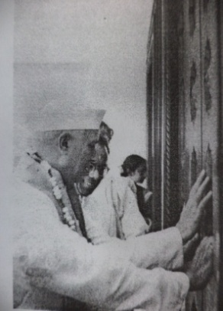
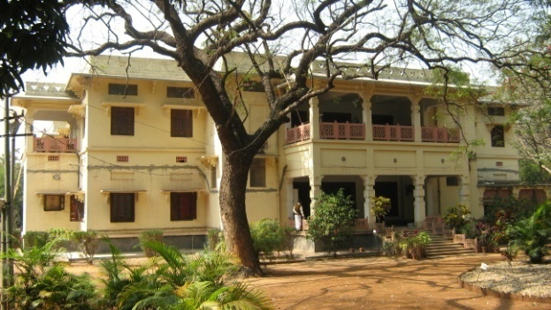
Conservation of Cultural Property
Dr. Pradip Kr Mandal
Curator, Rabindra-Bhavana
Visva-Bharati.
Notes:
PRADIP KUMAR MANDAL

Slide 2
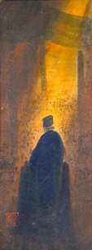
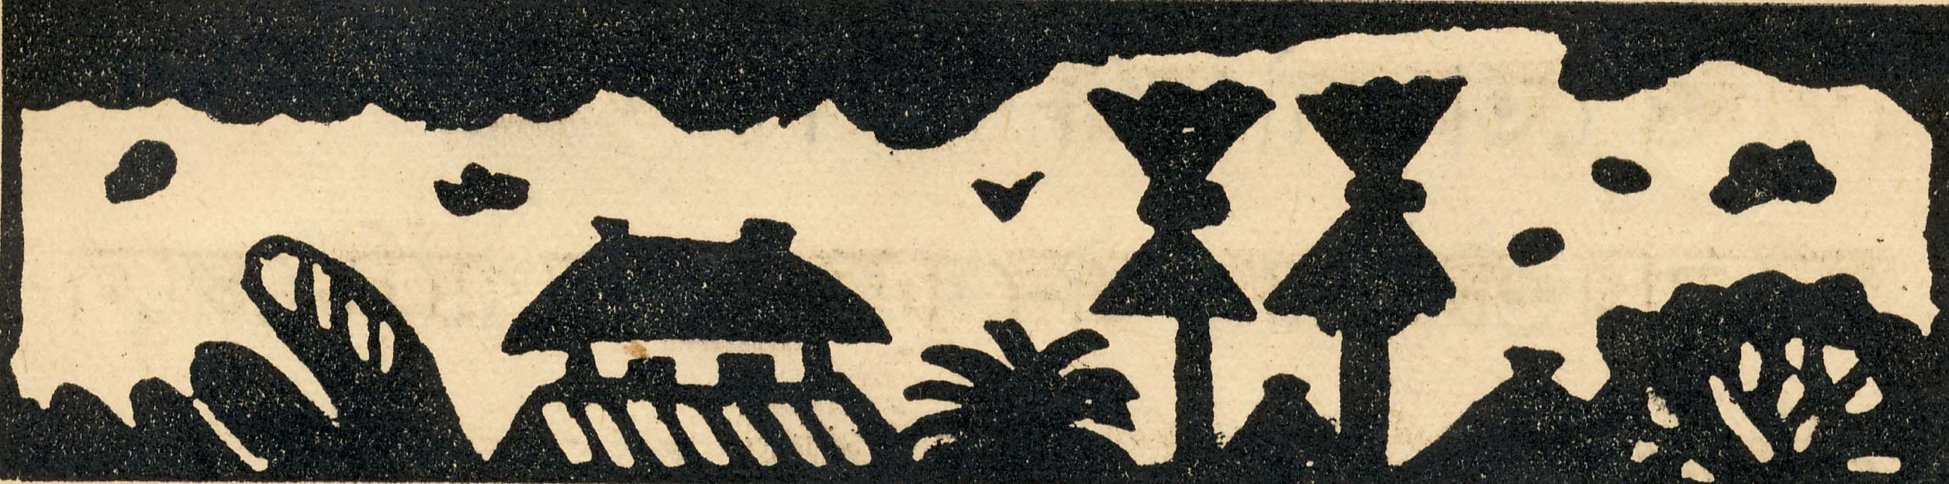
Tangible Heritage of Santiniketan
Architectures
Santiniketan Griha, Upasana Mandir, Chhatimtala, Teen Pahar, Dehali, Singha sadan
Dinantika, Dwijabiram, Taladwaj, Kalobari, Chena-Bhavana, Hindi-Bhavana
Building of Uttarayana etc.
Sculptures
Santal family, Lampset, Koler Bansi, The Fish, The Buddha, Hervestings and uncountable murals and relief etc.
Natural Heritages
Amrakunja, Bakulbithi, Amlaki bon, Madhabikunja, Shalbithi etc.
Arts and Crafts: Batik, Needle works, Dokra art, wooden crafts etc.

Slide 3
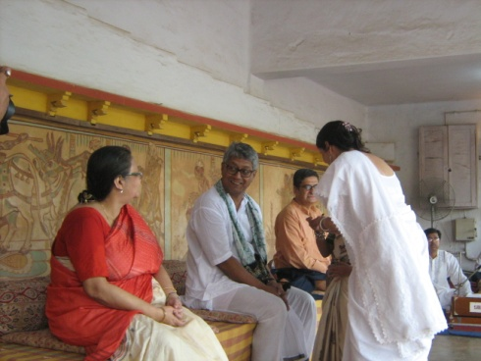
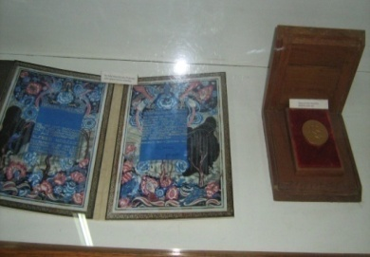
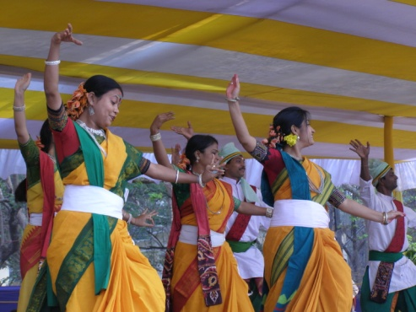
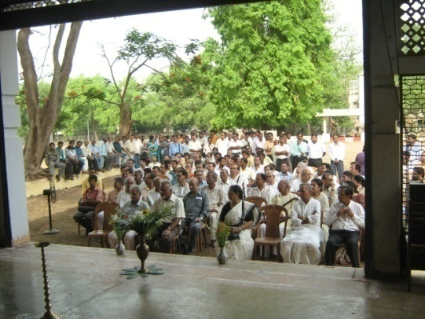
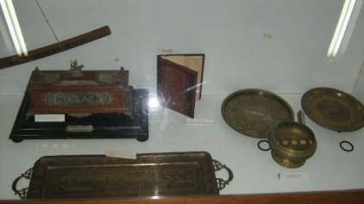
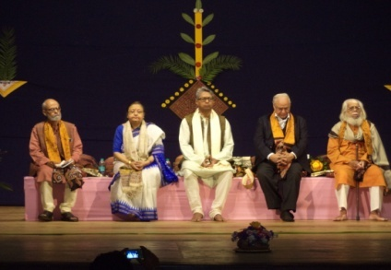
Living Museum deals with both Tangible and Intangible heritage
Intangible Heritage
Utsavs and Anustans
Traditional Cultural programmes
Classes with in nature etc.
Tangible
Historical Architectures
Murals
Reliefs
Sculptors
Gardens
Personal belongings
His manuscripts and letters
Paintings
Photographs
Books etc.
Notes:
Living Museum deals with both Tangible and Intangible heritage

Slide 4
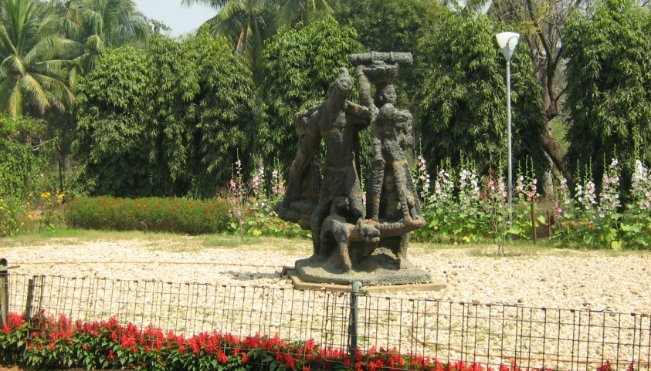
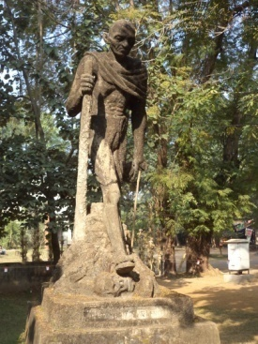
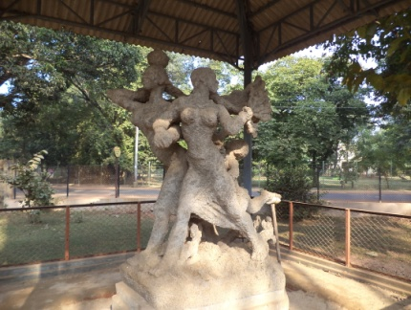
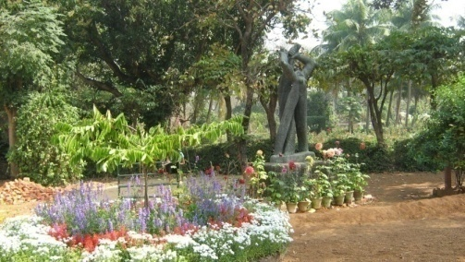
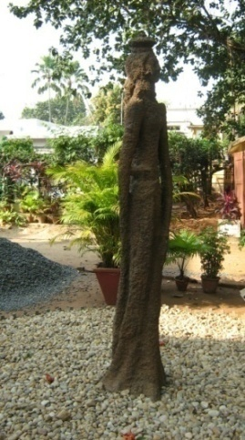
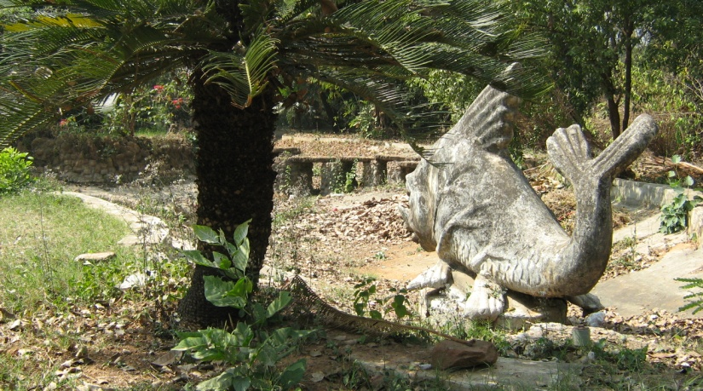
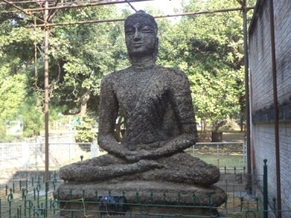
Few Sculptors by Ramkinkar
Koler Bansi
Mahatma’s Dandi March
Thaser
The Fish
Sujata
Buddha
Notes:
Koler Bansi

Slide 5
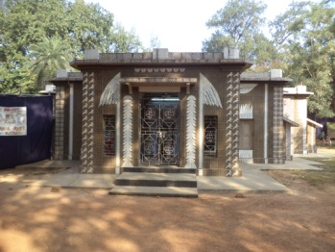
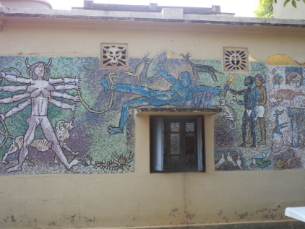
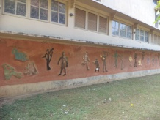
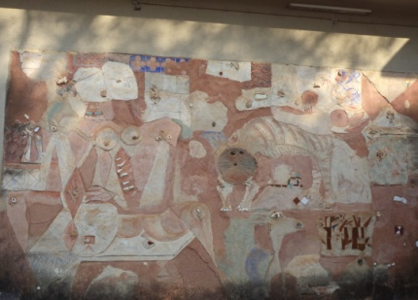
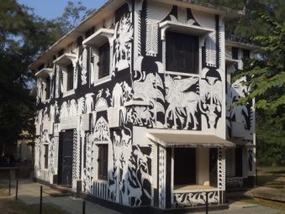
Studio of NandaLal Bose by K. G. Subhramonium
Murals by
Famous Artists
Somnath Hore
K. G. Subhramanium
Binodbihari Mukherjee
Somnath Hore
Notes:
Studio of NandaLal Bose by K. G. Subhramonium

Slide 6
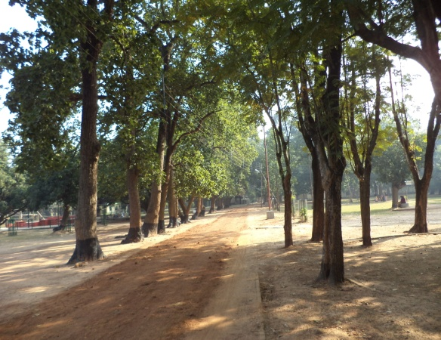
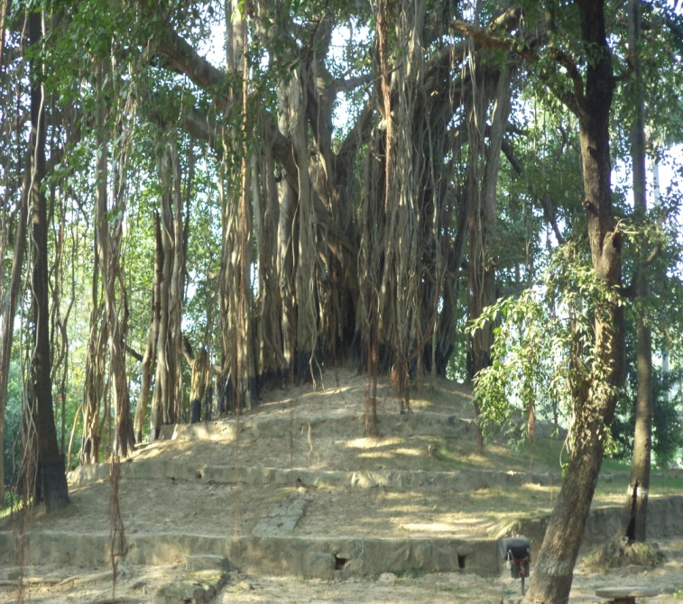
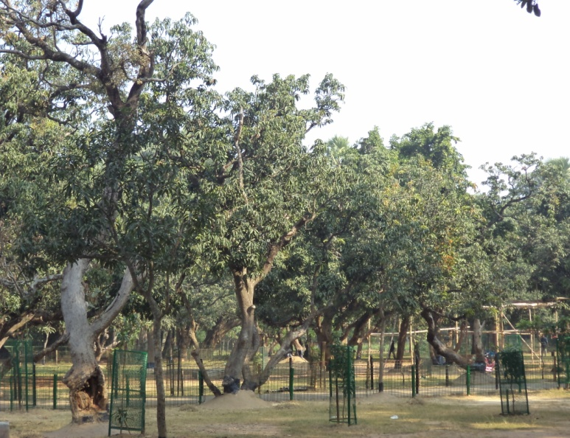
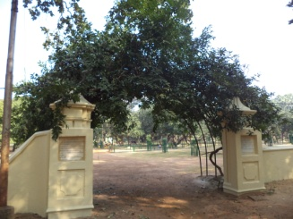
Shalbithi
Tin Pahar
Natural Heritages
Amrakunja
Madhabi Toron
Notes:
Shalbithi

Slide 7
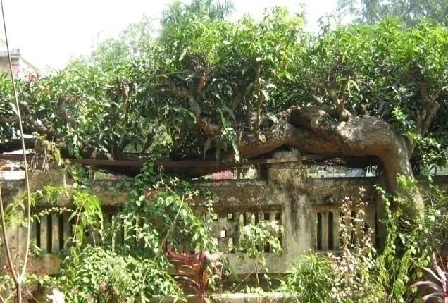

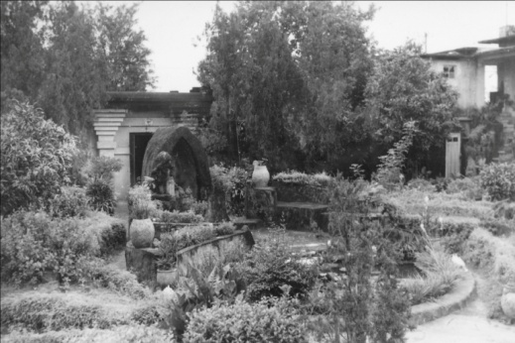
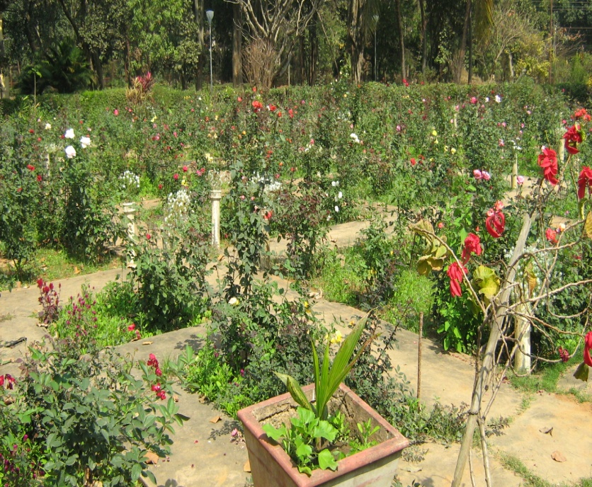
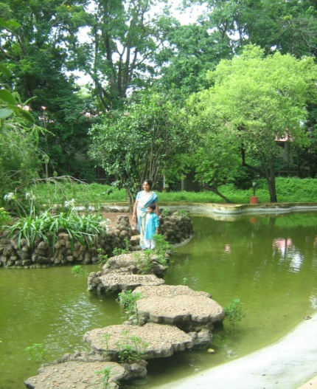
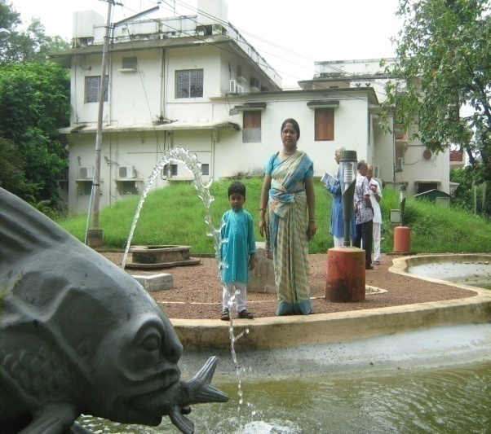
Natural Heritages of Uttrayana Garden
Creeper Garden by Rathindranath
Santal family by Ramkinkar Baij
Japanese Garden by Rathindranath
Rose Garden by Rathindranath
Pampa Lake by Rathindranath
The Fish by Ramkinkar Baij
Notes:
Historical Parts of Uttrayan Garden

Slide 8
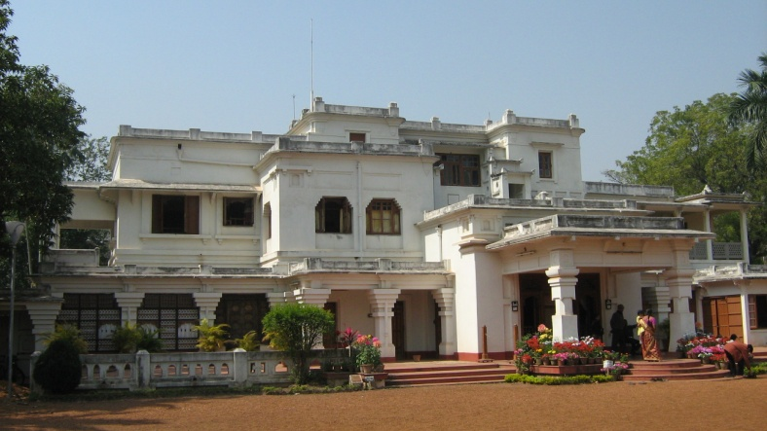
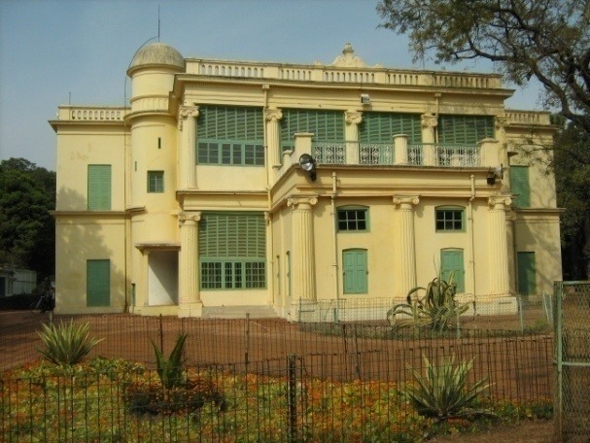
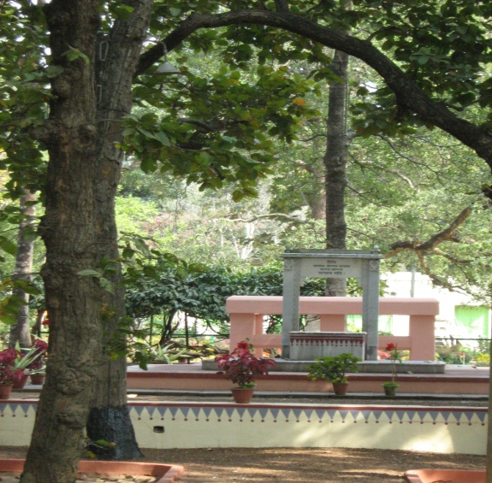
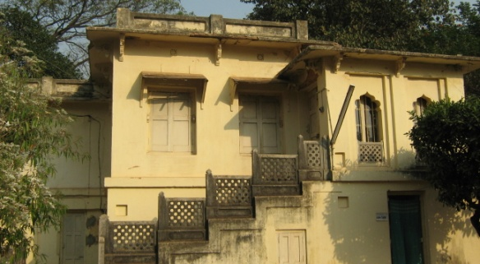
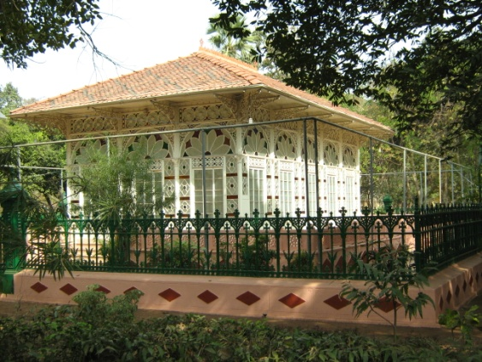
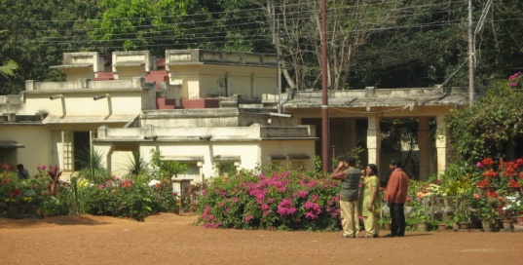
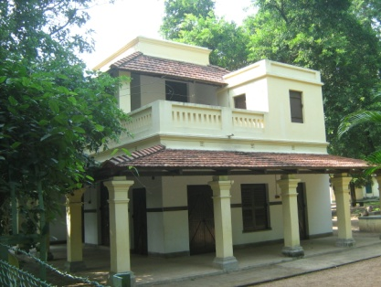
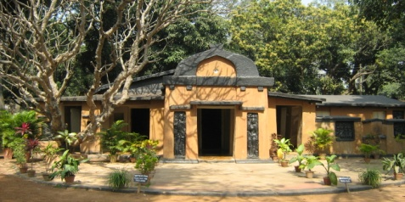
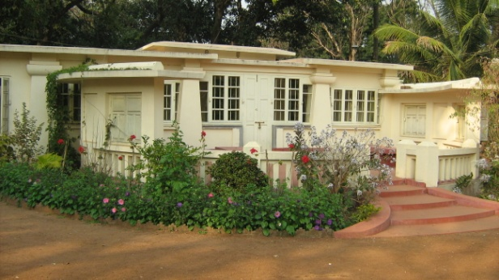
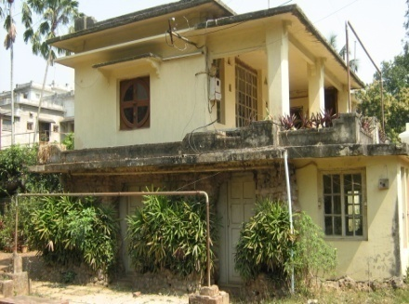
Historical Architectures in Santiniketan
Udayana
Santiniketan Griha
Udichi
Chhatim Tala
Konaraka
Upasana Mandir
Shyamali
Guhaghar & Chitrabhanu
Punascha
Notes:
Chhatim Tala

Slide 9
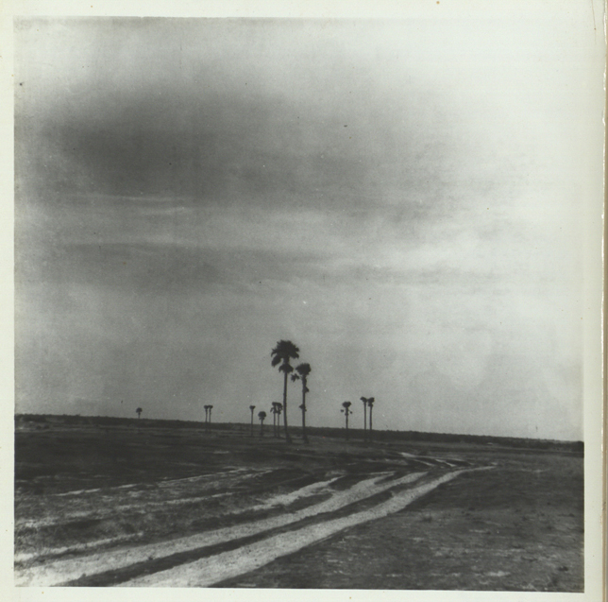
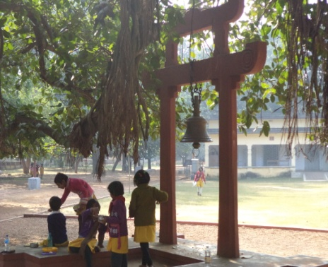

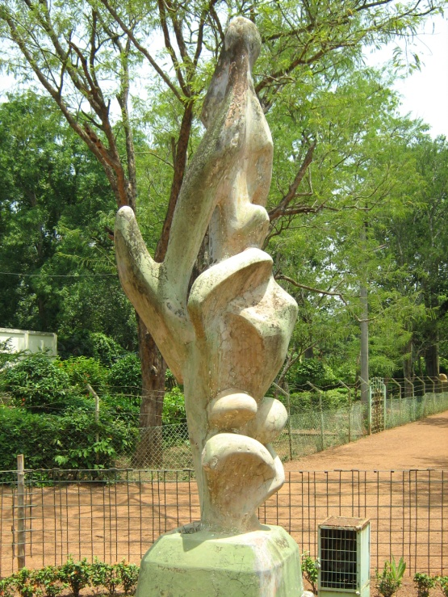
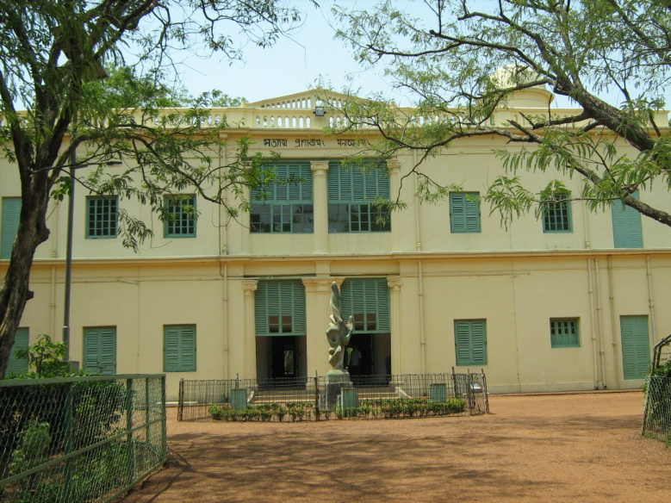
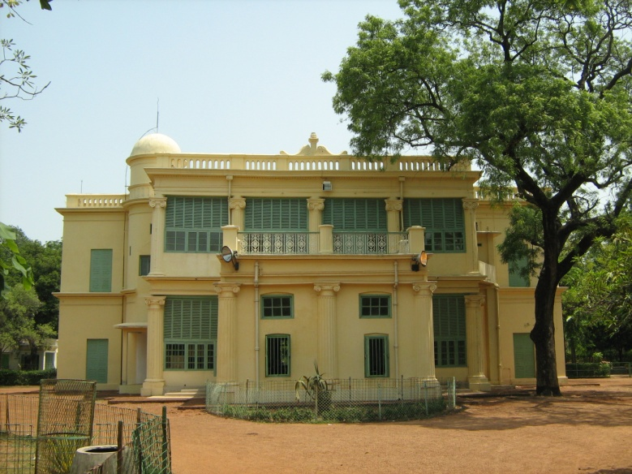
Bhubandangar Math
Gantatala
Chattim Tala
SANTINIKETAN GRIHA

Slide 10
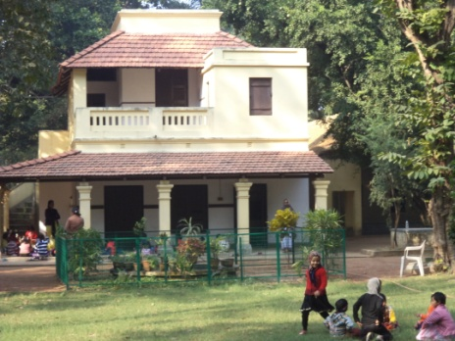
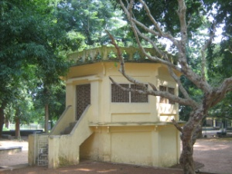
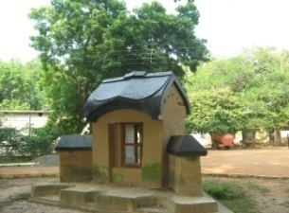
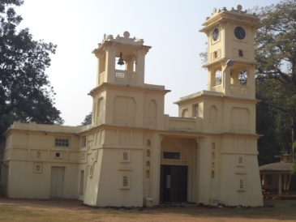


Historical Architectures' at Santiniketan
Dehali
Chaitya
Dinantika
Kalobari
Singha Sadan
Ghanta Tala

Slide 11



Rabindra-Bhavana
Collections at a glance
Total number 4115
Gold 19
Box, caskets etc 73
Personalia 214
Coin 6
Watches and clocks 8
Medals, degrees 303
Textile 47
Utensils 421
Wood work & leather craft 183
Kutum Katum 36
Sculptures 67
Swords 5
Type writer 2
Musical instruments 7
Tagore paintings 1582
Painting by other artists 703
Miscellaneous 229
Photo-Archives and Audio-Visual Collection
Approximately 15,000 photographs
Approximately 60,000 negatives
Glass negatives
Audio recordings
Video recordings
Autographed photographs

Slide 12


Rabindra Bhavana
Archives
at a Glance
Tagore manuscripts 1026 files
Press proofs 32 files
Correspondence (English) 513 files
Correspondences (Bengali) 960 files
Dwarkanath Tagore papers 8 files
Deendranath Tagore papers 5 files
Tagore family correspondence 30 files
Andrews papers 32 files
Visva-Bharati papers 22 files
Suprakash Ganguli collection 20 files
Mira Devi-Krapalani collection 50
P.C Mahalanobish collection 50
Manuscripts of
Rabindranath Tagore
Mahatma Gandhi
Albert Einstein
Helen Keller
Romain Rolland
Benito Mussolini
W.B. Yeats
Subhas Chandra Bose
Jawaharlal Nehru
Sarvapalli Radhakrisnan
Lord Chelmsford
Chittaranjan Das
Jagadish Chandra Bose
Okakura Kakuzo

Slide 13

Present collection of lipika Archives –
Bengali manuscripts - 10,000. (Aprox)
Sanskrit manuscripts – 6000. (Aprox)
Oriya manuscripts – 1102.
Surul records – 5000. bundle (Aprox)
Jaydev kaduli Records – 5000. bundle (Aprox)
Painted book cover – 100 (Aprox).

Slide 14




Lipika Archives and Rabindranath Tagore
Garanhata, Mechhuya Bazer, Bottala
Musalmani Puthi - - Dharma Katha, Prem Katha,
Pir Gatha
Meyeli Chhara, Brata Katha, Rupkatha, Baul Gan, Jogir Gan

Slide 15
Classification of Museum objects
Museum Objects
Composite
Textile, Paintings, ethnographical materials
Inorganic
Organic
Stone
Plant Product
Animal Product
Metal
Wood
Terracotta
Bark
Bone
Ivory
Horn
Antlar
Leather
Hair
Palm leaf
Ceramics
Parchment
Vellum
Silk
papyrus
Manuscripts
Glass
Cotton cloth
Letters
Non-Printed
Deeds
Diary
Paper
Printed ( book, journal etc)

Slide 16








Sculpture Tools, Building, temple, Monuments, Furniture, ornaments etc

Slide 17


Nepali Thanka And Water colour painting

Slide 18
Causes for Deterioration :
Manuscripts and organic documents are subjected to various forms of deterioration. Deterioration of paper and other cellulosic materials takes place due to various factors, which may be grouped as-
* Physical factors
** Biological factors
*** Chemical factors
**** Human factors

Slide 19
Causes for Deterioration :
Manuscripts and organic documents are subjected to various forms of deterioration. Deterioration of paper and other cellulosic materials takes place due to various factors, which may be grouped as-
* Physical factors
** Biological factors
*** Chemical factors
**** Human factors

Slide 20


1) Physical factors
Organic materials are gets physically weak and brittle by times. The causes of physical deterioration are light, heat and moisture
i). Light
Light, whether artificial or natural causes deterioration of cellulosic materials.
The colour changes to brown. The fibers get damaged and results in becoming brittle. Ultra-violet rays are particularly destructive. Ultra-violet light or unfiltered fluorescent lamps bleaches the inks and book covers. The amount of UV light which falls on archival materials should be monitored.
Types of Rays
UV Ray
Visual ray
Infrared Ray
V--I--B--G--Y--O--R
350nm
700nm

Slide 21

ii). fire
It is difficult to save organic materials when fire starts. Causes of fire can be due to electrical faults, smoking inside the buildings etc.
iii). Heat
Exposure to high temperature, even for short periods will cause paper like materials to become yellow & brittle and low temperature will generally retard the process of ageing.

Slide 22




iv). Moisture
The moisture content of organic materials also plays an important role its stability. When exposed to sun, it will lose moisture and contacts and paper will break. When more moisture is absorbed, it expends. Expansion and contraction reduces the strength of the paper. Paper should be preserved under a temperature of 18 C to 20 C and relative humidity of 55% to 60%.
Effect of Humidity on Palm leaf Manuscripts
Amount of water vapor in a volume of air
Relative Humidity=
X 100
Amount of water vapor to saturate same volume air in same temperature

Slide 23
Measuring Instrument and Units
Temperature
Thermometer/ Thermal Scanner
Celsius / F/K
Heat
Calorie meter
Calorie
Humidity
Hygrometer/
Tharmohygrograph
Percent
Light
Lax Meter
Lax
Data logger for continuous data temperature, humidity

Slide 24
Biological factors
In topical countries, biological agents cause great damage to cellulosic materials. The most important biological organisms are fungi, bacteria, algae, pest and protozoa. Insects such as cockroaches, silverfish and book worms damage the organic materials. The most dangerous insects are the termites. Other biological agents are rodents like rats.
Micro organism
Fungi are the most common cause of damage to all organic materials including paper and paper like materials. Fungi grow in a relative humidity ranging from 63% -100% and temperature range of 15 C – 35 C. fungal attacked archival materials turns black and are found to be weak. Writing ink is also effected by fungus.
ii) Foxing
The growth of brown spots on paper, cloth, birch bark of all types is called foxing. It is believed that foxing stains are due to the effect of the organic acids produced by the fungi and also in some cases due to the effect of chemical action of iron impurities in the above organic materials.

Slide 25




i) Acidity
Cellulose is attacked by acid and makes the paper brittle, fragile and discolouerd (brown)
The acidity is acquired either by the action of chemicals used in paper making or due to the chemical action with the environment for many years. Carbon-di-oxide forms carbonic acid, oxides of nitrogen form nitric acid, oxides of sulphuric acid which are absorbed by the paper and their acidity is increased. The acidity is measured by PH scale. The PH is the hydrogen ion concentration in the material in the moist condition.
During paper manufacture some chemicals like chlorine etc uses as bleaching agents and alum[Al2(SO4)3, K2SO4,24H2O], resin, glue, etc as sizing and filling materials which are also source of acids. Presently maximum papers are preparing from wooden pulp which contains lignin in presence of high humidity it produce Sulphuric acid (H2SO4). From Iron gol ink which contains ferrous and ferric sulphate [FeSO4 & Fe2(SO4)3] which are a important source of acid.
Potash Alum[Al2(SO4)3, K2SO4,24H2O] -- High RH------→ Sulphuric Acid (H2SO4)
Lignin (binding material of wood fiber __ High RH -----→ Sulphuric Acid (H2SO4)
Iron gal ink [FeSO4 & Fe2(SO4)3] ---------- High RH -----→ Sulphuric Acid (H2SO4)
Effect of Acidity its required Curative Preservation

Slide 26
Stone
Wood
Metal
Silk
Acid effect on the other types objects
Jute/Cotton/Papyrus/Palm leaf
Bone/Ivory/Horn/Antler
Leather/vellum/Parchment

Slide 27
iii
ii) Atmospheric Gases
carbon-di-oxide, nitrogen oxides, ammonia etc are the most damaging grasses. Because of the ultra-violet rays oxygen is converted in Ozone which affects the cellulose of paper and weakens it.
The most dangerous air pollutant is sulphur-di-oxide. The most common source of this gas is burning of oil and coal. Sulphur-di-oxide. The most common source of this gas is burning of oil and coal. Sulphur-di-oxide attack paper and causes discoloration, embrittlement and eventual disintegration of paper fibres.
Carbon di oxide (CO2) ---------------------- High RH ---------→ Calbonic Acid (H2CO3)
Nitrgen Oxcides(NO,N2O, NO2, N2O3) ------ High RH -----→ Nitric Acid (HNO3)
Sulpher Oxides (SO2, SO3) ------------------- High RH -----→ Sulphuric Acid (H2SO4)
iii) Dust
Dust is a mixture of gas particles, solid particles, solidified gas etc. It enters in the spine of the books and causes damage.
vi) Dirt
Dust when mixed with any other liquid becomes dirt. Dust becomes dirt due to moisture and the micro-organisms grow over them and affect the paper.

Slide 28





v) Human Factors
Besides chemical, physical and biological factors, human factors are also responsible for the deterioration of paper.
i) Innocence and negligence
ii) Rough handling
iii) Improper Storage
iv) Repairing with scotch tape
v) Ink or coffee stain
vi) Dog marking
vii) Writing with ball pen
viii) Covering with acidic paper
ix) Using metallic pins and clips- The pins & clips get rusted and affect
the paper.
Keeping paper inside the books- This results in warping of covers

Slide 29
Care and Maintenance of Organic Materials
In conservation of paper documents, two aspects are involved:
Preventive conservation.
Curative conservation.
For preservation of organic documents certain precautions for their proper maintenance have to be taken. Even after it is restored and repaired, it needs constant care for its preservation as organic documents or materials are subject to natural ageing and decay.
Notes:
Responsibility

Slide 30


Conservation Is a
continuous process
Unequal Fight

Slide 31








To save our heritage
First we have to know the Object, their material content, Their Condition aggressor aggressors .
Very good observation is essential to preserve

Slide 32
Regular Maintenance
Checking before Exhibition
Object finger print
Condition Report
Responsibility
Scientific Storing
Treatment History
Exhibition
Lab Documentation

Slide 33
Environment control-
organic materials should be maintained in on ideal environment. The relative humidity should be 50-60% and temperature 18 C-20 C, light level at a minimum of 50 lux it can be extended up to 150 lux.
Climate of a building can be controlled through air-conditioning but it should be constant and maintained through out 24 hours of a day.
Silica gel crystals placed inside sealed showcases and cupboards can modify the relative humidity. The colour of silica gel changes from blue to pink when it absorbs moisture. When it become pink, should be heated to re-use.
To reduce the level of humidity in closed space, dehumidifiers are used. Hygrometers are used to measure the relative humidity.

Slide 34
Control of light-
The effect of light can be controlled by taking the following precautions:
Reduce the intensity of light only for a short period of time.
Expose the objects to the light only for a short period of time.
Filter out photo chemically active radiations like the ultra-violet rays from the light.
Through the recommended level of light for paper paintings is 50 lux, it can be increased to about 150 lux. Frosted glass, Zinc oxide, louvered glass etc can be use as UV filter.

Slide 35
iii) Dust-
Vacuum is the the best method to remove dust. Windows must be provided with dust filters. When air-conditioning is done, dust filters should be provided. Along with the dust bacteria, spores of fungi etc. are also removed.
iv) Gases-
Oxides of carbon, nitrogen & sulpher etc absorbed by the manuscripts increases acidity and finally results in damage. When air-conditioning is done, provisions should be given to absorb the harmful gases and to send good pollution free air inside.

Slide 36
iv) Protection from Biological Agents-
In order to protect manuscripts from biological agents, the paper, materials should be kept in an ideal condition of temperature(18-20 C) and relative humidity (50%-60). Use of some chemicals may control the growth of the biological agents.
Fumigation-
Fumigation is a process of treating paper materials with chemicals in the vapor phase for about 4-6 days. For use of fumigants, a fumigation chamber is needed.
Fumigants are substances whose vapor kills insects. They may be in the form of solids, liquids or gasses applied, but they must possess the property of ready volatility.
National Archives, New Delhi have installed vacuum fumigation chambers in which ethylene oxide and carbon-dioxide gasses in the ratio 1:9 are sent into chambers stored with archival materials under vacuum for 4 to 5 hours. However, it has several disadvantages and in some countries it is totally banned.
Fumigation is a temporary process and it has to be repeated periodical intervals.
Some of the fumigants used are Ethylene oxide, thymol, methyl bromide, ethyl bromide,
Naphthalene etc.

Slide 37
Insecticides
Insecticides kills insects. Some of the Insecticides are arsenic oxide, aldrin, para dichlorobenzene, naphthalene etc. some of them are harmful to the users too. Therefore almost care should be taken in handling them.
Fungicides
Thymol is a universal Fungicide. The fungal attacked paper materials are fumigated in a chamber with thymol at about 35-45 C for a week and the fungus are killed.
Non-toxic method
Paper material may be exposed to nitrogen atmosphere for few hours to eradicate insect and fungus. This is very safe as there are no side effects.

Slide 38

Deacidification
Litmus paper
Aqua's Method
Non-aquas Method
Mass Method
Lime water
Magnesium methaoxide
Barium hydrooxide
Bleaching
Yellowish or blackish
printed paper
White printed paper
Ca(ocl)cl for cl and H2o2 for O

Slide 39





Training for Manuscripts handling, Reading, storing and Conserve To Save the National wealth
Notes:
Training for Manuscripts handling, Reading, storing and Conserve

Slide 40



Cleaning of archival materials
A paper document gets affected due to marks, spots or stains etc. For example by fungus, ink, water etc. need to be cleaned. This is the matter of conservater, we should regularly dusting, cleaning and care fully handling which will be helpful to protect manuscripts from new spots and stains.
Soft flat brush may be used for cleaning paper may be gentle dusting. Brushing, not only removes dust but also the dead insect bodies or their eggs. All dust removed should be colleted on polythene sheet and disposed off properly so that it does not spread in the room.
Wrong dusting Proper dusting Good quality brush for dusting

Slide 41











Traditional Conservation
Red cloth
Yellow cloth
Clove oil
Citronella oil
Black Cumin
Dry Neem leaf
Sandal wood dust
Tamarind Seed for Glue
Notes:
Tamarind Seed Glue

Slide 42
Arrangement
Paper Materials
Shorting
Palm Leaf
Metals
Leather/Vellum/Parchment
Stone
Clay
Packing
Box
Wrapping
Box/Wraping/Indidual
Labeling
Rack / Group Labeling
Almirah Labeling
Rack
Storing
Almirah
Movie stack

Slide 43


Storing

Slide 44




Thank You

